Slide 1
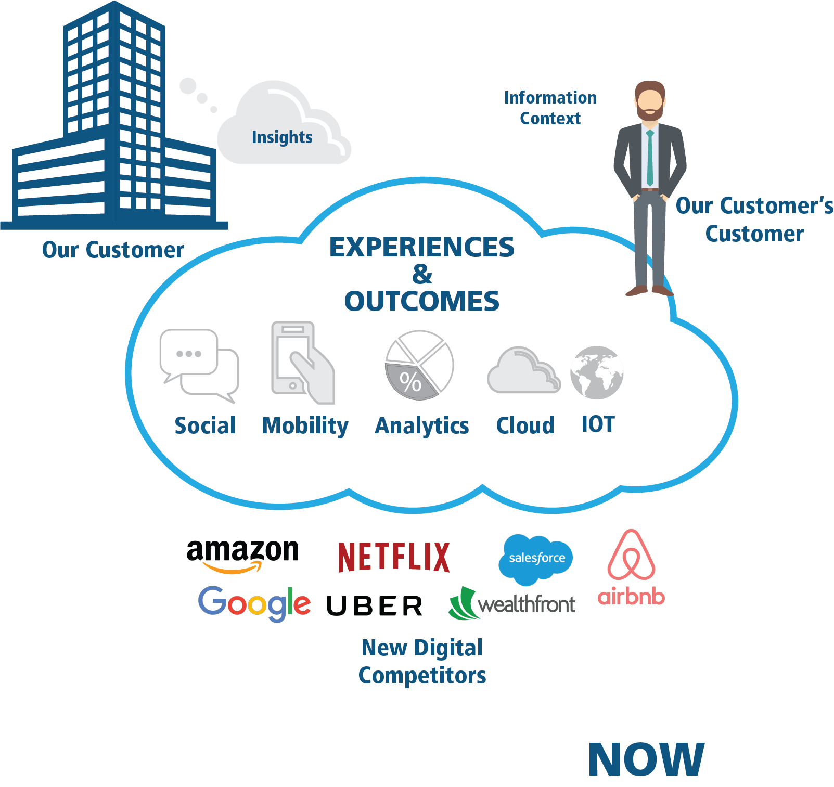
What Issues Are Businesses Facing Today?

Slide 2

Customers are demanding to move from a world of custom integration
Application silos
ERP
The back office
CRM
The front office
Business
Intelligence
Hard coded processes
Disconnected data

Slide 3






Dynamics 365 enables this new world
INSIGHTS
Marketing
CRM
ERP
Talent
Sales
Dynamics 365
Retail
Field Service
Finance and Operations
Customer
Service
Project Service Automation
BUSINESS PROCESSES
Azure
Power BI
PowerApps
Microsoft Flow
Common Data Service

Slide 4
Dynamics 365
one platform – many applications
Anything
management
Supplier management
Student management
Patient management
Contracts management
Veteran
management
Recruiting
management
Asset management
Risk
management
Offender management
Vendor management
Azure
Power BI
PowerApps
Microsoft Flow
Common Data Service

Slide 5
Home Health Use Case

Slide 6







Home Health Digital Transformation Showcase
INDUSTRY SPECIALIZATION
NON-TRADITIONAL D365 USE CASE
AZURE
Home Health
Healthcare Industry Solution
IoT Data is stored in Azure
DIGITAL TRANSFORMATION
PARTNER SOLUTION
INTERNET OF THINGS (IoT)
BUSINESS INTELLIGENCE
MOBILITY
Tribridge Health360 IP, built on Dynamics 365 (xRM)
IoT enabled health monitoring devices
Tribridge PowerBI Field Service Templates
Mobile IP solution
Notes:
By the numbers

Slide 7





Use Case: Alert to Home Health Appointment
Bluetooth-enabled Blood Pressure Cuff
Joseph:
Patient
Lori:
Clinical Care Team
Cory:
Remote Nurse
Brian:
Scheduling Specialist
Joseph has been provided with Bluetooth-enabled blood pressure cuff which sends readings which are integrated to the Health360 database. On Wednesday morning, Joseph used the cuff and an abnormal reading generated a Clinical Alert to Care Team
Joseph is a patient with Hypertension and is enrolled in a Care Management program so that the Clinical Care Team can help him better manage his high blood pressure..
Lori, a member of the Clinical Care Team sees the Clinical Alert in Health360 and reviews the patient record. Lori contacts the patient and through intervention determines a Home Visit is needed. Upon completing the Intervention record in Health360, Lori submits a request for a Home Health Appointment.
Cory receives the booked appointment on his mobile device. He travels to Joseph’s home. Cory completes the assessment form from his device and the results are stored in Health360
Brian, a scheduling specialist receives Lori’s appointment request. He reviews the availability and skills of Remote Nurses near Joseph and assigns the Appointment to Cory.

Slide 8


Customer success with Health360…

Slide 9
Home Health Solution Map
Home Health Business Front Office Processes
Care
Coordination
Referral
management
Care
Plans
Skills
management
Recruiting
management
Dynamics 365 Modules and Components
Sales
management
Account
management
Contact
management
Customer Service
management
Case
management
Field Service
management
Scheduling
management
Marketing
management
Activity
management
Queue
management
Resource
management
Office 365, Cortana
Microsoft Dynamics 365 Platform
Portals, Mobile
User Interface
API, Apps, Flow
Workflow
Power BI, IOT,
Cortana Analytics
Reporting | Analytics
Security
Operations, Billing, Finance
Common Data Model

Slide 10
Connected Data: Dynamics 365
Shipments
Orders
Forecast
Accounts
Support case
Equipment maintenance
Service requests
Opportunities

Slide 11
Connected Data: Dynamics 365 + Office 365
Tasks
Shipments
Calendar
Documents
Orders
Forecast
Accounts
Email
Message
Support case
People
Meetings
Equipment maintenance
Service requests
Storage
Opportunities

Slide 12
Connected Data: Dynamics 365 + Office 365 + LinkedIn
Tasks
Relationships
Shipments
Calendar
Documents
Job History
Orders
Talent
Forecast
Accounts
Email
Message
Support case
People
Meetings
Skills
Equipment maintenance
Professional contacts
Service requests
Storage
Opportunities

Slide 13
Connected Data: Dynamics 365 + Office 365 + LinkedIn + Partner Solutions
Tasks
Relationships
Planograms
Shipments
Calendar
Documents
Trade promotion
Job History
Orders
Talent
Patients
Forecast
Accounts
Email
Message
Device Data
Support case
People
Meetings
Skills
Equipment maintenance
Professional contacts
Service requests
Storage
Merchandise
Opportunities

